Slide 1
ITSC 306: Computer Forensics
Module 4, Week 5: Non-Volatile Disk Captures

Slide 2
Module Textbook Readings
Chapter 6

Slide 3
Introduction
Capturing non-volatile disk captures is a two-step approach: acquire the media and then authenticate the media.
Only after the media is acquired and authenticated can an analysis start.
There are several tools and ways to acquire media
Free, open-source tools that can be used in both Linux and Windows
Specialized, paid forensic suites such as FTK, EnCase and X-Ways

Slide 4
Step 1 — Check for Encryption
Before any live system is powered down, it is extremely important to confirm whether the suspect drive is encrypted.
If you pulled the plug on a live system and discovered later that the drive had full disk encryption running and if the RAM was not acquired or did not provide keys, it is unlikely that any data can be read from your acquisition.

Slide 5
Encrypted Disk Detector (EDD)
Magnet Forensics offers EDD for free (https://www.magnetforensics.com/free-tool-encrypted-disk-detector/)
EDD is a command line tool that checks physical disks on a live Windows system to confirm whether encryption is running on any of the volumes.
EDD checks for TrueCrypt, PGP, Bitlocker, Safeboot, BestCrypt, Checkpoint, Sophos or Symantec.
Note: EDD checks for encryption on mounted drives.

Slide 6
Running EDD
Place the executable on removable media.
Open an administrator command prompt.
Navigate to the location containing the executable.
Run EDD.exe.
Accept the User Agreement.
Review the results.

Slide 7
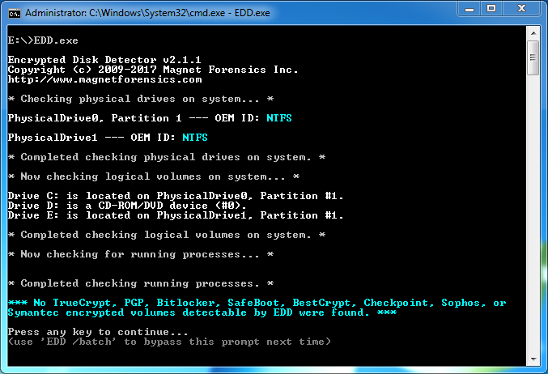
Results - EDD
Used with permission from Microsoft.

Slide 8
Step 2 — Prepare the Target Media
Once the seized media has been identified, removed from a system (e.g., a hard drive removed from a computer) and documented, prepare the target drive (the drive the image will be written to) before acquisition.
Wipe the target drive (usually a hard drive) before acquisition to ensure no other data is stored on the drive.
By wiping the target media, you can definitively state that evidence located on the drive came from the suspect media and not from other investigations.
Wiping involves writing zeros or any random string of characters to each sector on the drive.

Slide 9
Wiping a Drive using DCFLDD
Wipe all data on the target drive using DCFLDD.
sudo dcfldd bs=4k conv=noerror of=/dev/zero of=/dev/(device)
sudo dcfldd bs=4k conv=noerror of=/dev/zero of=/dev/sdc

Slide 10
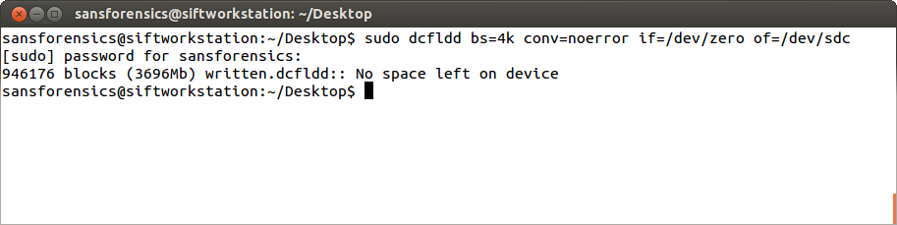
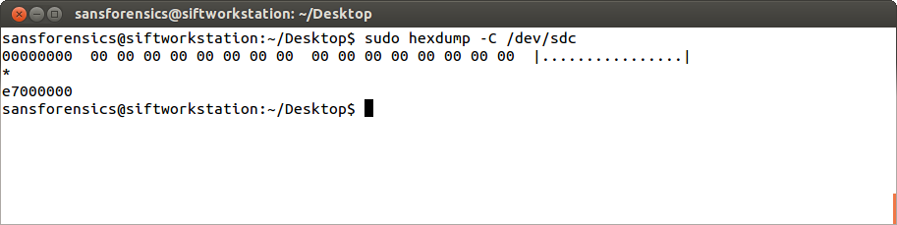
Hexdump confirms the Wipe
Source: SANS Institute. Reproduced and used in accordance with the fair dealing provisions in section 29 of the Canadian Copyright Act for the purposes of education, research or private study. Further distribution may infringe copyright.

Slide 11
Step 3 — Partition the Drive
FAT32
- 4 GB maximum file size and 2 TB volumes
- read/write compatible with OSs
NTFS
- 16 EB file size
- Faster read/write
- Linux requires NTFS-3G driver support
exFAT
- Similar to FAT32 but without the 4 GB file limit
- May require driver support depending on your Linux distribution
Ext4
- Current Linux standard if using specifically for Linux

Slide 12
Partition the Drive
If using Windows and acquiring Windows media, format drives using NTFS.
If using Linux to acquire and analyze, use Ext4.
Smaller acquisitions can use FAT32 or exFAT partitioned drives when using both Windows and Linux.

Slide 13
Step 4 — Write Protection
To ensure no data changes on the suspect media, use a write blocker.
Hardware write-blockers are used to ensure the integrity of imaging media.
Once placed between the suspect and target media, no data can be written to the suspect media.
This process ensures the integrity of the acquisition.

Slide 14
Linux Write Protection
The Linux OS can also be used to write protect suspect media.
The process involves mounting the drive as read only.
SIFT will auto-mount a USB drive. Run mount to confirm mount points.
The drive can be remounted as read only.

Slide 15
Linux Write Protection
Run the following command:
sudo mount --options=remount,ro /media/(mount point)
sudo mount --options=remount,ro /media/Rooney

Slide 16
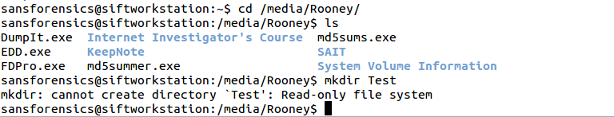
Linux Write Protection
When you attempt to write to the drive, the OS will report the drive is read-only.

Slide 17
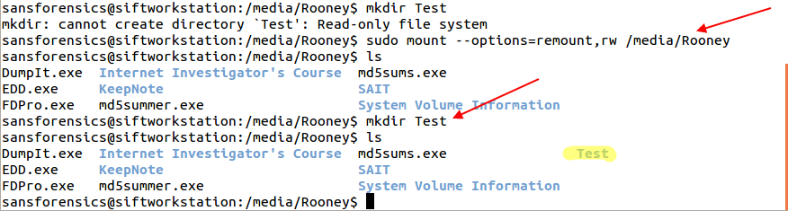
Linux Write Protection
To return to Read-Write, issue the command as rw.
sudo mount –-options=remount,rw /media/(mount point)
sudo mount –-options=remount,rw /media/Rooney

Slide 18
Step 5 — Attaching and Recognizing Suspect Media in Linux
You can use two main commands to attach and recognise devices in Linux.
The first command is dmesg. This prints the kernel buffer ring.
The kernel buffer ring records messages related to the operation of the kernel. In this case, attached drives.

Slide 19
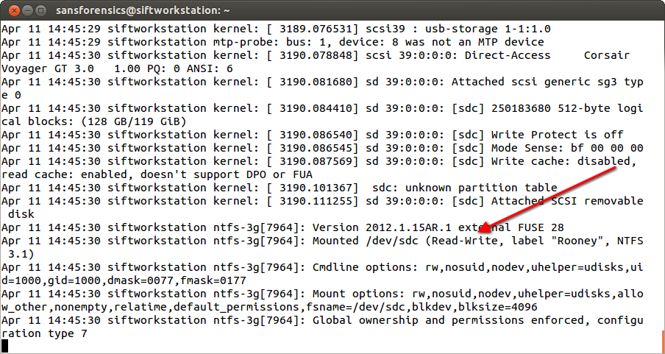
dmesg

Slide 20
Step 6 — Attaching and Recognizing Suspect Media in Linux
The second command is: tail –f /var/log/syslog
The log file /var/log/syslog contains system log information.
By running the tail command, you can watch new devices being attached to the system in real time.
Run the command in a terminal, and then attach your USB.
Tail reads the last few lines of the syslog, and the -f flag advises to follow the syslog file.

Slide 21
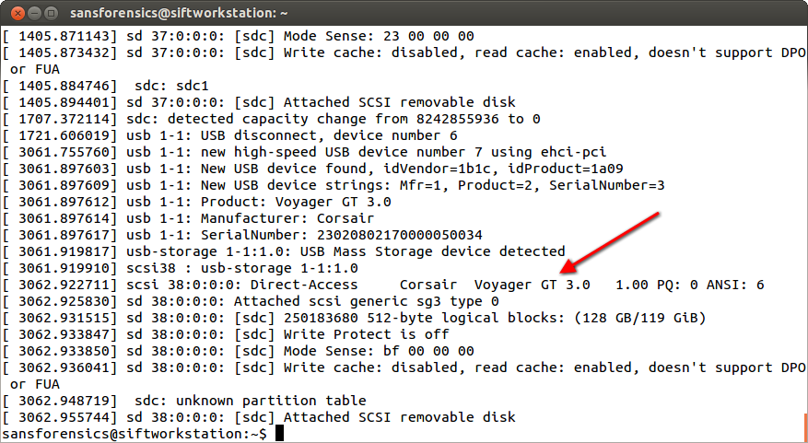
Step 6 — Attaching and Recognizing Suspect Media in Linux

Slide 22
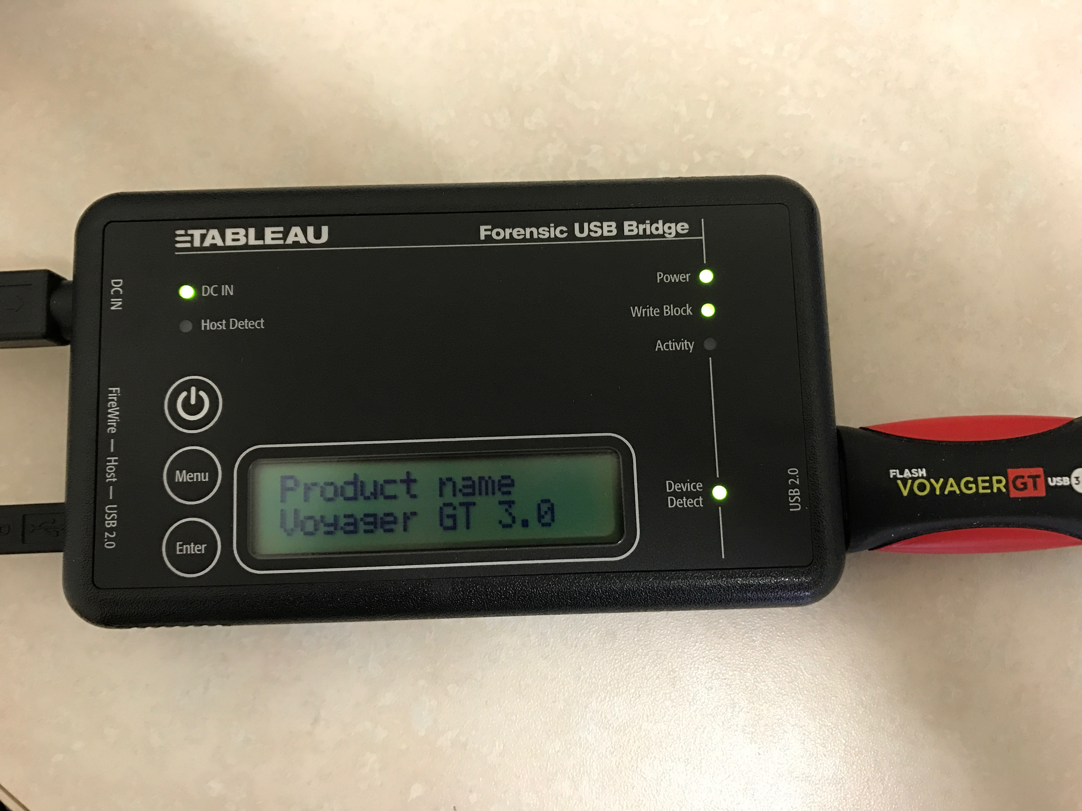
Step 6 — Attaching and Recognizing Suspect Media in Windows
Because Windows auto-mounts everything, you must use a write-blocker.
In this example, a USB drive is connected through a Tableau USB write-blocker.

Slide 23
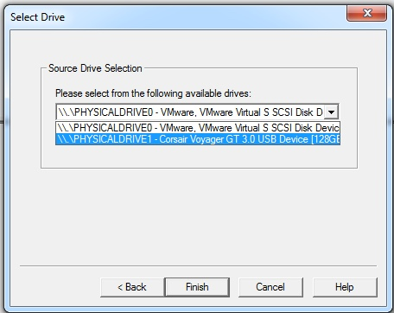
Step 6 — Attaching and Recognizing Suspect Media in Windows
In Windows, the drive is automatically recognised
Can be viewed but not written to
FTK Imager recognises the drive.
Source: FTK Imager. Reproduced and used in accordance with the fair dealing provisions in section 29 of the Canadian Copyright Act for the purposes of education, research or private study. Further distribution may infringe copyright

Slide 24
Step 7 — Acquisition - Linux Tools
DD - Convert and Copy a File
[ dd ] = small Linux program that copies and converts data
The program has a number of flags that can be utilized:
[ bs ] = block size (the amount of data transferred.)
[ if ] = Input File (read from file and not stdin)
[ of ] = Output File (write to file and not stdout)
[ conv=noerror ] = (convert the file and continue after read errors)
[ sync ] Pad any areas from read errors

Slide 25
Linux dd - Example
Running the command sudo dd if=/dev/sdc of=image.raw copies the entire physical device.
This acquisition is relatively slow because we did not set the bs parameter. The default bs is 512 bytes.
If not set, the kernel defaults and reads 1024 bytes at a time. For every 1k, dd reads 512 and throws away the other 512. On the next 1024, it re-reads the 512 that was thrown away.

Slide 26
Linux dd - Example
To speed up the acquisition, increase the size of the block size.
Running the command sudo dd if=/dev/sdc bs=4k of=image2.raw is much faster.
In this example, no data is being thrown away.
Unless numerous read errors are received, increase the bs to speed the acquisition.

Slide 27
conv=noerror
By default, DD stops the process if it encounters a read error.
To continue the acquisition without stopping, implement the conv=noerror option.
This option skips over read errors and continues with the acquisition.
Note that because errors are skipped, the acquired file will be smaller than the original.
This may result in the file being unable to be mounted.

Slide 28
sync
The option sync pads the read errors with zeros.
To put it all together:
sudo if=/dev/sdc bs=4k conv=noerror,sync of=image3.raw

Slide 29
dd Variants - dcfldd and dc3dd
dcfldd and dc3dd are two variants of dd developed explicitly for forensics.
dcfldd has additional options such as authentication during acquisition, a status log, file segmentation and the ability to write to more than one output file at a time.

Slide 30
dcfldd
Run the following command to acquire a device and write a hash log to a text file.
sudo dcfldd if=/dev/sdc bs=4k conv=noerror of=dcfldd.img hashlog=dcfldd.txt
Note that dcfldd provides a running status log to stdout during acquisition.

Slide 31
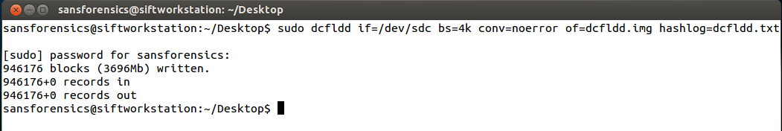
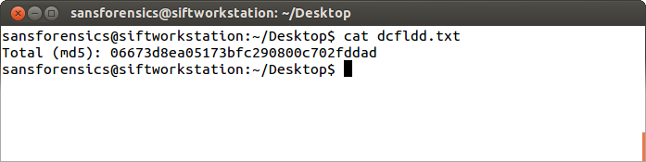
dcfldd

Slide 32
dc3dd
Unlike dd or dcfldd, dc3dd manages errors during acquisition. Therefore, the conv=noerror,sync flag is not needed.
dc3dd if=/dev/sdc of=image.raw log=error.log
Note that dc3dd also provides a real-time status of the acquisition.

Slide 33
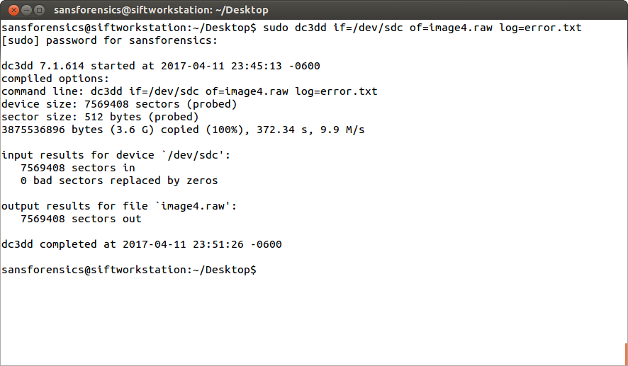
dc3dd

Slide 34
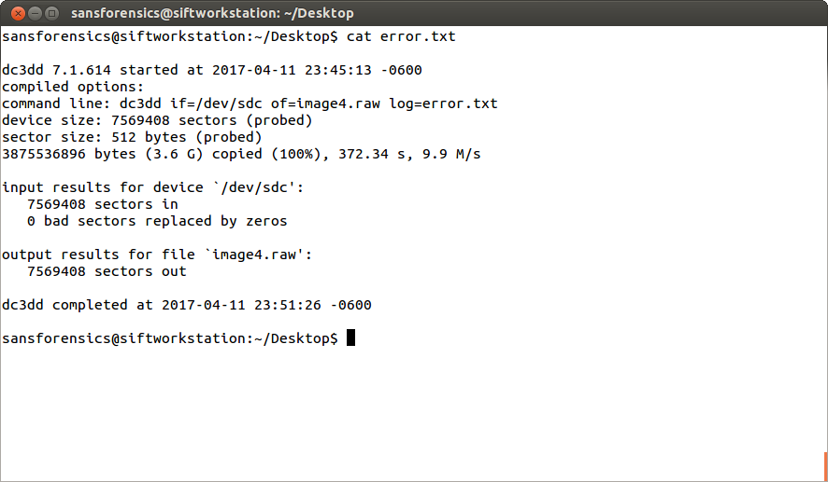
cat error.txt

Slide 35
ftkimager – Command Line
AccessData provides a free, command line version of FTK Imager (http://accessdata.com/product-download)
Available for Windows, OSX, Debian, Ubuntu, Fedora and Red Hat
SIFT is based on Ubuntu

Slide 36
ftkimager – Installation
Download the Debian and Ubuntu 32bit – 3.1.1 version.
Extract the file from the Downloads folder: sudo tar –xzvf ftkimager.3.1.1_ubuntu32.tar.gz
Move the ftkimager file: sudo mv ftkimager /user/local/bin

Slide 37
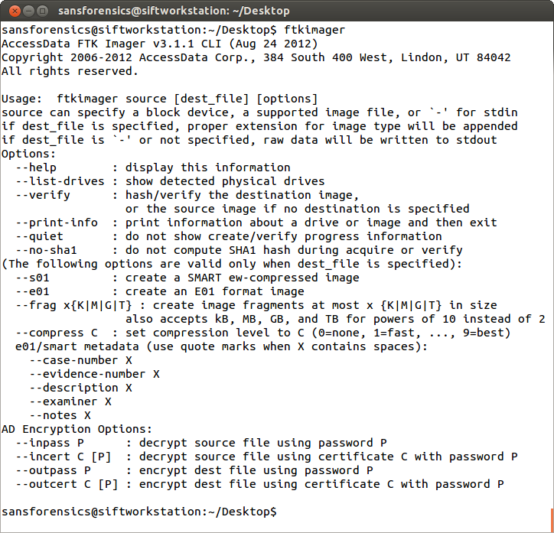
ftkimager – Options

Slide 38
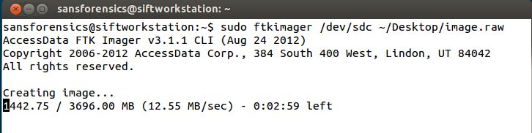
ftkimager – Imaging
To use ftkimager, run the following basic command:
sudo ftkimager /dev/sdc ~/Desktop/image.raw
Ftkimager provides a running status and time estimation.

Slide 39
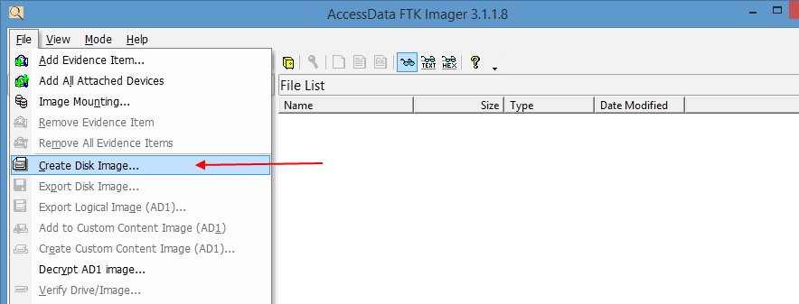
Forensic Suites – FTK Imager_Lite in Windows
Select File > Create Disk Image.
Source: FTK Imager Lite software. Reproduced and used in accordance with the fair dealing provisions in section 29 of the Canadian Copyright Act for the purposes of education, research or private study. Further distribution may infringe copyright.

Slide 40
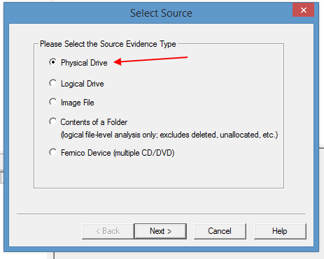
Forensic Suites – FTK Imager_Lite in Windows
Select Physical Drive.
Source: FTK Imager Lite software. Reproduced and used in accordance with the fair dealing provisions in section 29 of the Canadian Copyright Act for the purposes of education, research or private study. Further distribution may infringe copyright.
Notes:
For forensic analysis, the investigator will always choose physical image so he or she has access to everything on the drive.
Logical can be used for RAIDs or a Server.
You can image the contents of a folder.
Select Image File is you want to convert an image. For example, you captured an E01 image and want to convert it to DD.

Slide 41
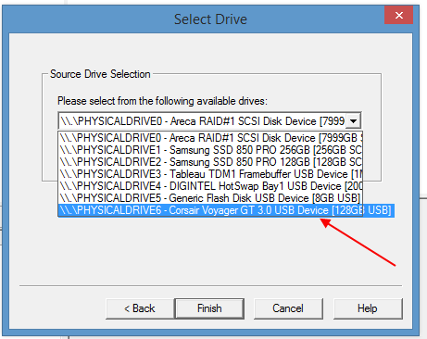
Forensic Suites – FTK Imager_Lite in Windows
Navigate to and select the identified physical drive.
Source: FTK Imager Lite software. Reproduced and used in accordance with the fair dealing provisions in section 29 of the Canadian Copyright Act for the purposes of education, research or private study. Further distribution may infringe copyright.
Notes:
Physical Drive Zero will the Operating System.
Focus on the size and labels to identify the suspect drive.

Slide 42
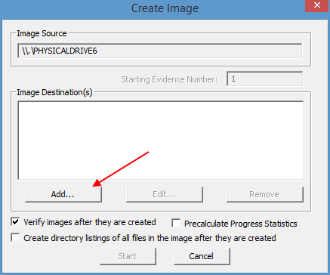
Forensic Suites – FTK Imager_Lite in Windows
Select Add in Image Destination.
FTK requests the Image Type.
FTK supports the following formats:
- Raw (dd)
- SMART (ASR Data)
- E01 (EnCase)
- AFF (FTK)
Source: FTK Imager Lite software. Reproduced and used in accordance with the fair dealing provisions in section 29 of the Canadian Copyright Act for the purposes of education, research or private study. Further distribution may infringe copyright.

Slide 43
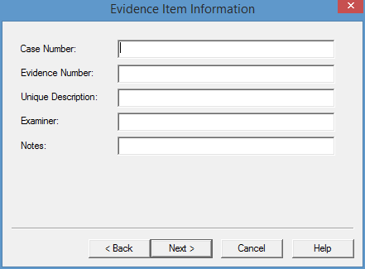
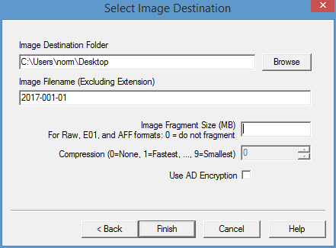
Forensic Suites – FTK Imager_Lite in Windows
Complete the investigation information and decide if you want to fragment the image or use compression.
When complete, select Finish.
Source: FTK Imager Lite software. Reproduced and used in accordance with the fair dealing provisions in section 29 of the Canadian Copyright Act for the purposes of education, research or private study. Further distribution may infringe copyright.
Notes:
FTK suggests not to use Fragmentation is capturing RAW, E01, or AFF formats.
Compression slows the process.

Slide 44
Forensic Suites – SMART
SMART Linux is a Linux-based forensic suite that can be used for acquisition and analysis within a Linux environment.
Live Linux Boot CD based on Ubuntu.
SMART Linux (http://www.asrdata.com/forensic-software/smart-linux/) can be installed on your Linux OS.

Slide 45
Forensic Suites – Tableau Imager
Tableau is a Windows-based free imager from Guidance Software (https://www.guidancesoftware.com/ tableau/download-center)
Add notes to the image
Capture to RAW or E01
Segment to the image
Provides hashing
Used through a write-blocker

Slide 46
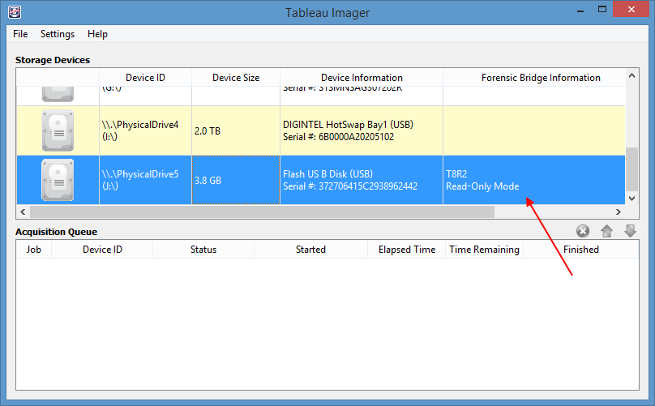
Forensic Suites – Tableau Imager
When starting TI, note that the program confirms the use of a write-blocker.
Source: Tableau Imager Software. Reproduced and used in accordance with the fair dealing provisions in section 29 of the Canadian Copyright Act for the purposes of education, research or private study. Further distribution may infringe copyright.

Slide 47
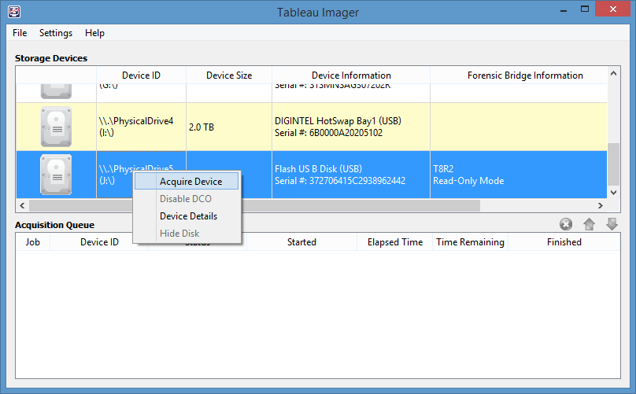
Forensic Suites – Tableau Imager
Right-click the device and select Acquire.
TI provides device info (drive letter) and information about the device.
Source: Tableau Imager Software. Reproduced and used in accordance with the fair dealing provisions in section 29 of the Canadian Copyright Act for the purposes of education, research or private study. Further distribution may infringe copyright.

Slide 48
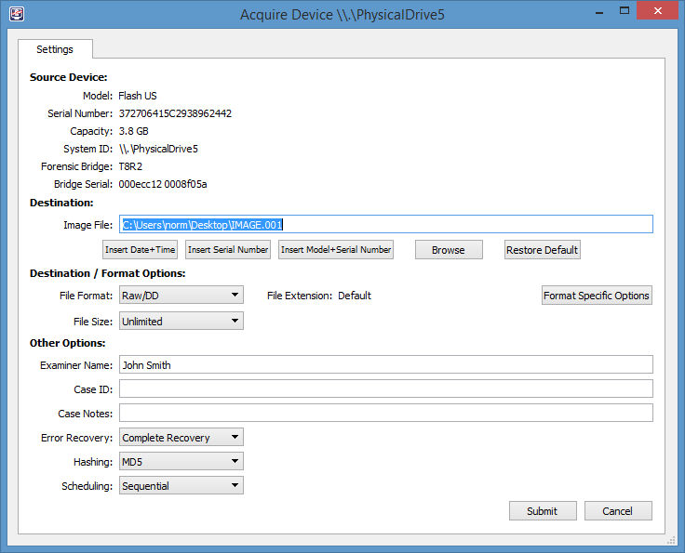
Forensic Suites – Tableau Imager
Complete the capture details and click Submit.
Source: Tableau Imager Software. Reproduced and used in accordance with the fair dealing provisions in section 29 of the Canadian Copyright Act for the purposes of education, research or private study. Further distribution may infringe copyright.

Slide 49
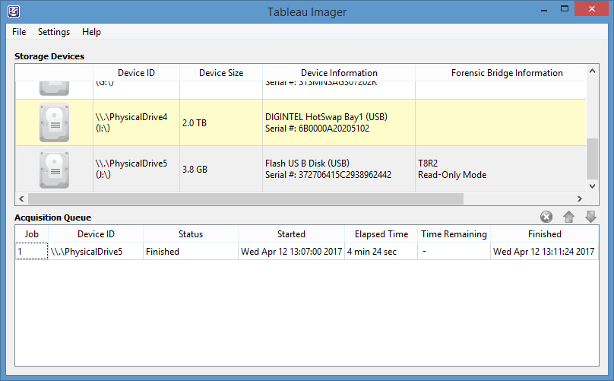
Forensic Suites – Tableau Imager
TI provides a running status and Start and Finished date and time.
Source: Tableau Imager Software. Reproduced and used in accordance with the fair dealing provisions in section 29 of the Canadian Copyright Act for the purposes of education, research or private study. Further distribution may infringe copyright.

Slide 50
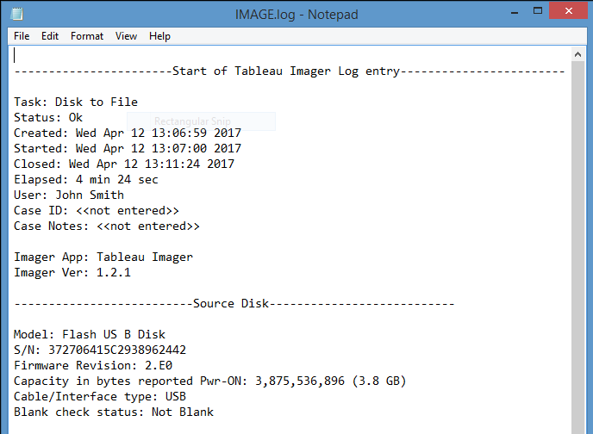
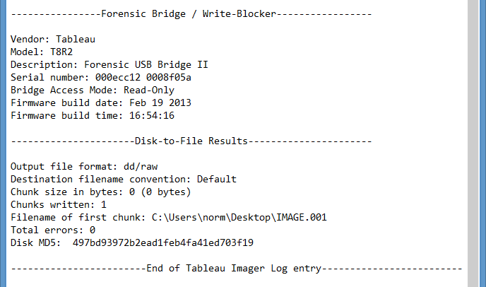
Forensic Suites – Tableau Imager
TI also provides a Image.log file on the capture details.
Used with permission from Microsoft.

Slide 51
Summary
Capturing non-volatile disk captures is a two-step approach: acquire and authenticate.
Only when you are satisfied that you have a sound forensic image can analysis start.
Before any live system is powered down, it is extremely important to confirm is the suspect drive is encrypted.
If it is encrypted, image the logical drive and capture the RAM before shutting down the system.
Prepare the target drive by ensuring the drive has been wiped of any other evidence and then formatted based on your forensic system and suspect media.
There are many open-source programs to acquire media in both Linux and Windows OSs.

Slide 52
References
AccessData. (2010). FTK Imager Lite (Version 3.1.1) [Computer software]. Retrieved from http://accessdata.com/product-download/ftk-imager-lite-version-3.1.1
Guidance Software. (2017). Tableau Imager Software (Version 1.2.1) [Computer software]. Retrieved from https://www.guidancesoftware.com/tableau/download-center
SANS Institute (2017). SIFT Workstation [VMware Appliance]. Retrieved from https://digital-forensics.sans.org/community/downloads

Slide 53
© 2017, Southern Alberta Institute of Technology. All rights reserved.
This publication and materials herein are protected by applicable intellectual property laws. Unauthorized reproduction and distribution of this publication in whole or part is prohibited.
For more information, contact:
Director, Centre for Instructional Technology and Development
Southern Alberta Institute of Technology
1301 16 Ave. N.W., Calgary, AB T2M 0L4

